Slide 1
Workshop: Problem Identification & AI Feasibility
Theme: Solving Real Nigerian Challenges with Intelligence
Objective: Moving from "That’s a cool idea" (a social problem) to "This is a viable AI project" (a technical AI use case).

Slide 2
The Framework – The "Three-Pillars"
To identify a viable AI project, we must satisfy three criteria:
The Pain Point: Is the problem significant enough in the Nigerian context?
The Stakeholders: Who owns the data, who pays for the solution, and who is the end-user?
The Feasibility: Can AI actually solve this, or is it just a process/policy issue?

Slide 3
Identifying the "Real" Problem
Before we code, we must define. A good AI problem isn't just "Agriculture is hard." It’s specific.
Symptoms vs. Root Causes: Don't build for the symptom (e.g., "People are hungry"). Build for the cause (e.g., "40% of tomatoes rot during transport from Kano to Lagos").
The "So What?" Test: If you solve this, who saves money, gains time, or improves their life?
Nigerian Context: Focus on sectors with high friction: Fintech, Logistics, Agrotech, and Energy.
Focus on high-impact sectors. Ask: Where is there a data-rich inefficiency?
Agriculture: Crop disease detection via imagery or yield prediction.
Fintech: Credit scoring for the unbanked or localized fraud detection.
Healthcare: Predicting malaria outbreaks or diagnostic support for rural areas.
Logistics: Route optimization for erratic urban traffic (e.g., Lagos/Abuja).
Notes:
Two models with the same accuracy behave very differently in deployment. Why? Distribution shift and variance: Because accuracy is an average, while deployment exposes models to changing data distributions and different levels of variance.

Slide 4
Stakeholders Mapping
You cannot build AI in a vacuum. Every AI solution lives in an ecosystem. Who are the players?
You must identify:
Primary Users/Beneficiaries: Those whose daily lives are improved. Who interacts with the model/app? (e.g., the small holder farmer) or Who gains from the output? (e.g., the consumer paying lower prices).
Data Providers: Agencies or private firms that hold the historical records.
Decision Makers/Gatekeepers: The authorities who must approve or fund the deployment. Who can stop your project? (e.g., Regulators like NITDA or CBN).
The "Human-in-the-Loop": Who validates the AI’s output before action is taken?

Slide 5
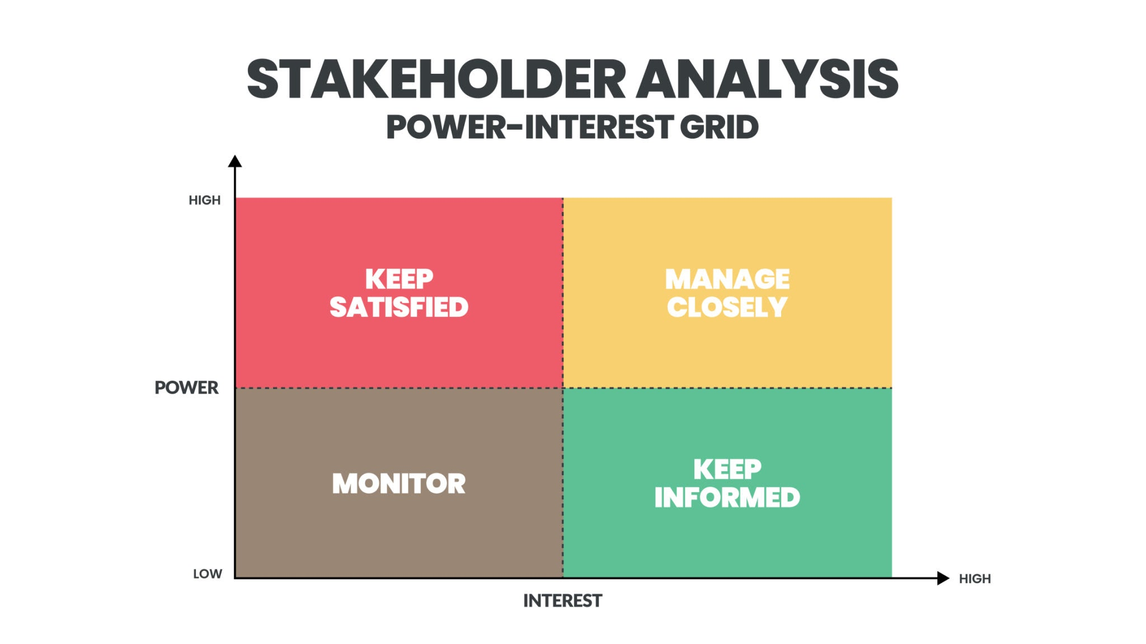
The Iceberg Model
Notes:
Unintended Consequences
Definition: Outcomes that are not intended by a purposeful action.
The Challenge: AI solutions often have "side effects."
Example: Automating credit scores in Fintech might unintentionally exclude people without smartphones, worsening financial inequality.
Question to Ask: "If we 'fix' this, what happens to the rest of the system?"

Slide 6
The 3 Pillars of AI Feasibility
Before writing code, ask these technical questions. Can AI actually solve this? Evaluate your idea against these:
Data Availability: Do we have—or can we get—clean, labelled data in Nigeria? Does digital, structured, or semi-structured data exist?
Pattern Presence: Is there a repeatable pattern that a machine can learn?
Cost of Error: What happens if the model is wrong? (High-risk vs. Low-risk).
Technical Viability: Is this a simple prediction (ML) or a complex vision task (DL)? Do we have the compute power?
Deployment: Does the target environment have the connectivity/hardware to run the model?
Value Impact: Is the "lift" from AI worth the cost? (e.g., Is a 5% increase in crop yield worth a $10,000 model?).
Notes:
Unintended Consequences
Definition: Outcomes that are not intended by a purposeful action.
The Challenge: AI solutions often have "side effects."
Example: Automating credit scores in Fintech might unintentionally exclude people without smartphones, worsening financial inequality.
Question to Ask: "If we 'fix' this, what happens to the rest of the system?"

Slide 7
Activity – Group Breakout
Task: Identify one localised problem and fill the "Problem Canvas."
Step 1: Write a the "Problem Statement" in one or two sentences.
Step 2: List 3/4 key stakeholders (Primary Users, Gatekeepers, etc.).
Step 3: Rate your Data Feasibility (1-10) and justify why.
Step 4: Propose a learning paradigm (Supervised, Unsupervised, etc.) and the required data.
Step 4: Identify the biggest "blocker" to feasibility.
Output: Prepare a 2-minute "Elevator Pitch" for the class.

Slide 8
Peer Feedback & Critique
Groups will present for 3 minutes. Peers should critique based on:
Specificity: Is the problem too broad (e.g., "Fixing Poverty")?
Data Realism: Is the required data actually accessible in Nigeria?
Actionability: Does the AI output lead to a clear real-world action?
When listening to other groups, ask these "Hard Questions":
"Where exactly will you get the data from?"
"Does this actually need AI, or just a better spreadsheet/website?"
"What happens if the model is wrong 10% of the time? Is it dangerous?"

Slide 9
📋 AI Problem Canvas
Group Name: ___________________________
The Problem Title: ____________________________________________________
1. The Problem Statement
Describe the inefficiency or pain point. Who is suffering, and what is the current manual "workaround"?
Drafting Tip: Avoid "We want to build an app." Instead, try "Smallholder farmers lose 30% of crops to pests because they lack early detection tools."
2. Stakeholder Analysis
The Beneficiary: (Who uses the solution?)
The Buyer/Sponsor: (Who pays for it?)
The Data Gatekeeper: (Who owns the records? e.g., NITDA, Banks, Hospitals)
3. The AI Mechanism (Feasibility)
Target Variable: What specifically are you trying to predict or classify?
Learning Paradigm: (Supervised, Unsupervised, Reinforcement, etc.)
Data Source: Where will the data come from? (e.g., Satellite imagery, SMS logs, Field surveys)
4. Nigerian Context & Constraints
Infrastructure: Does this require constant 4G/5G? Can it work offline?
Language/Culture: Are there localized nuances (dialects, slang) the model needs to understand?
Ethics & Privacy: Are there sensitivity issues around the data (e.g., tribal or religious data)?
5. Success Metrics
Technical Metric: (e.g., F1-Score, RMSE, Accuracy)
Impact Metric: (e.g., "Reduce delivery time by 15%" or "Increase loan approval rates for women by 20%")

Slide 10
Conclusion
Summary: A well-defined problem is 50% of the solution.
Refine: Take the feedback to narrow your project scope.
Next Step: Begin gathering data for the problems you identified today. Start investigating public data sources (e.g., NBS, Kaggle, or scraping).

